Slide 1
Predicting House Prices on Kaggle
Eng Teong Cheah

Slide 2
Objective
Real data often contains a mix of different datatypes and needs to be preprocessed.

Slide 3
Contents
Predicting House Prices on Kaggle

Slide 4
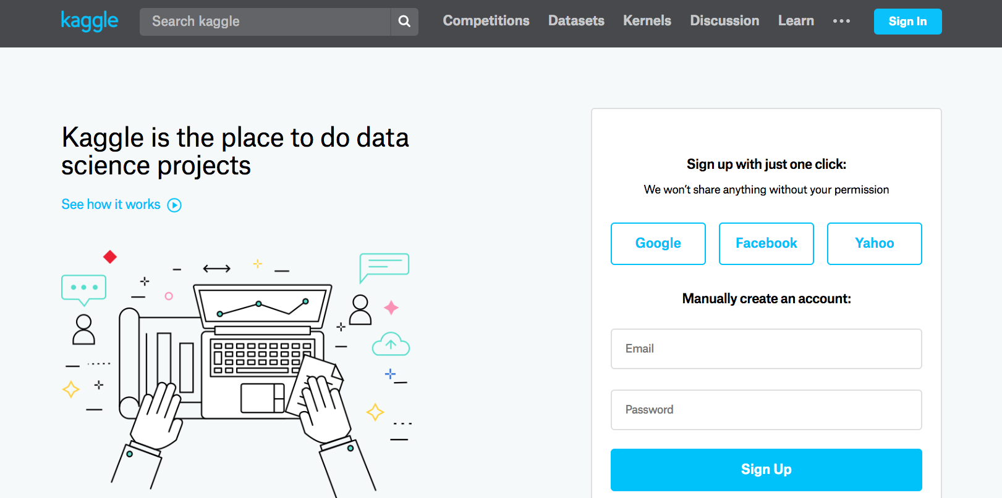
Kaggle

Slide 5
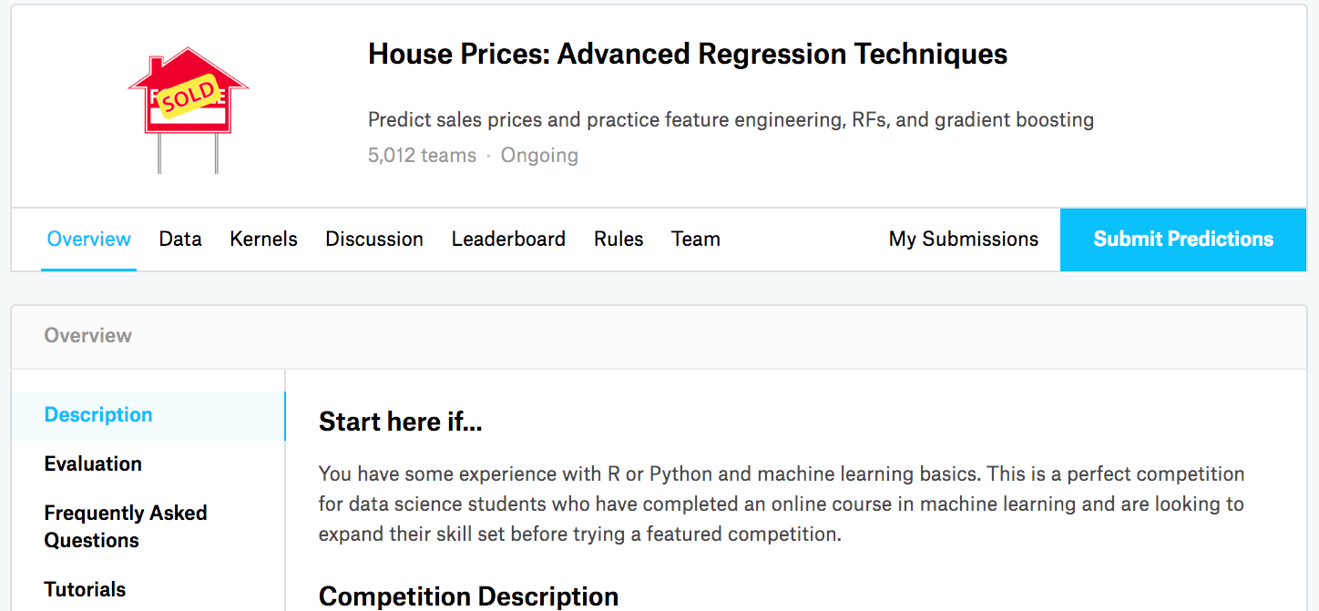
Kaggle
https://www.kaggle.com/c/house-prices-advanced-regression-techniques

Slide 6
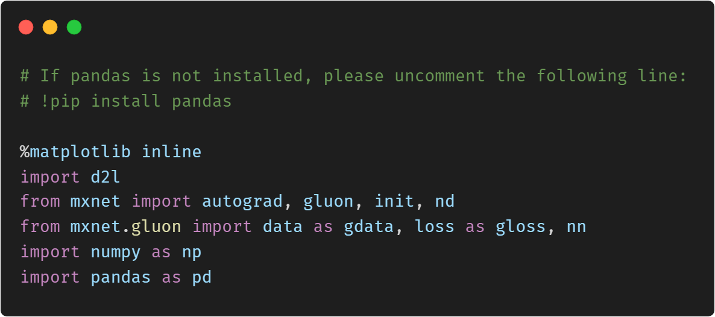
Accessing and Reading Data Sets

Slide 7
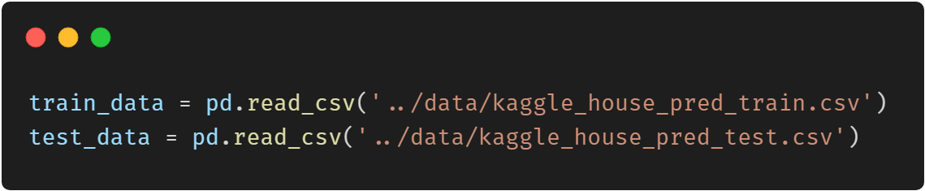
Accessing and Reading Data Sets

Slide 8
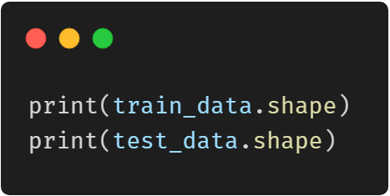
Accessing and Reading Data Sets

Slide 9
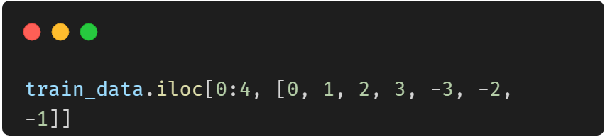
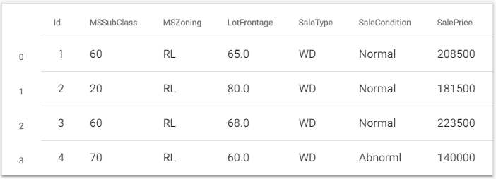
Accessing and Reading Data Sets

Slide 10
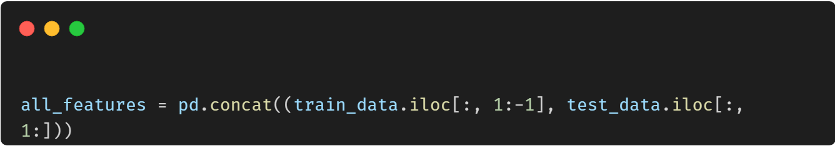
Accessing and Reading Data Sets

Slide 11
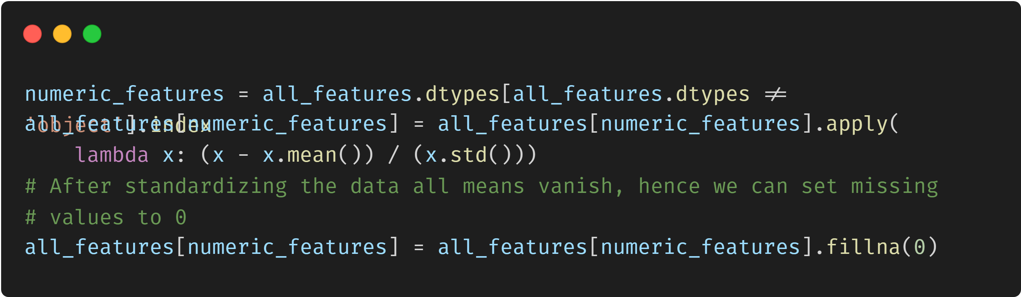
Data Preprocessing

Slide 12
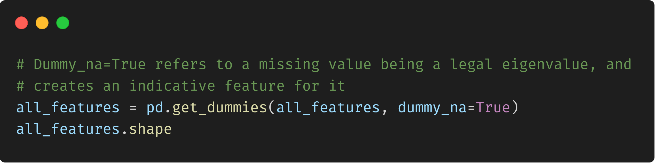
Data Preprocessing

Slide 13
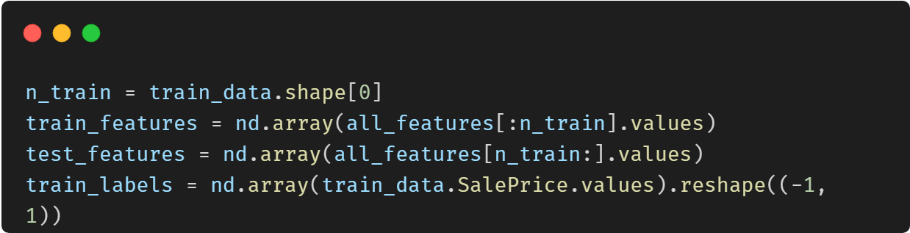
Data Preprocessing

Slide 14
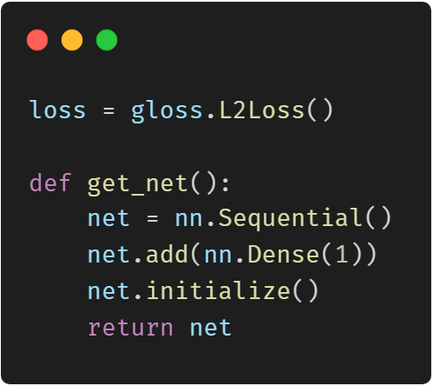
Training

Slide 15

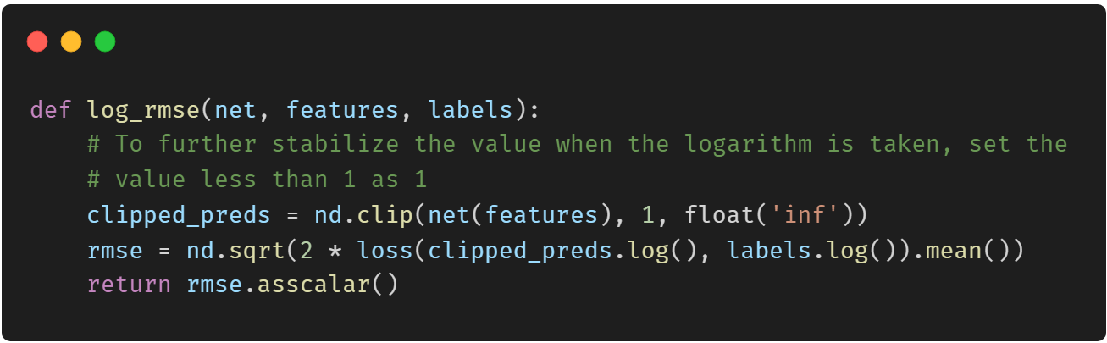
Training

Slide 16
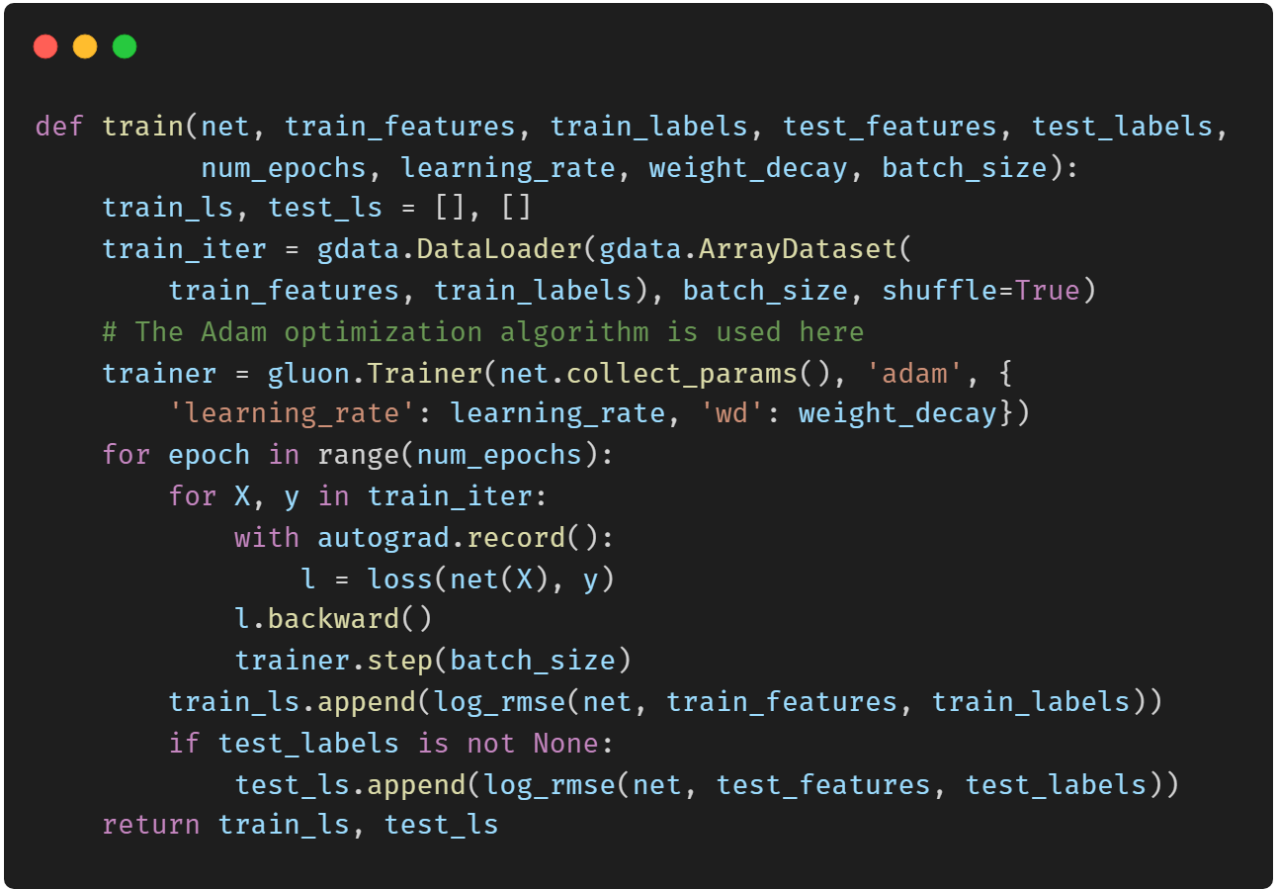
Training

Slide 17
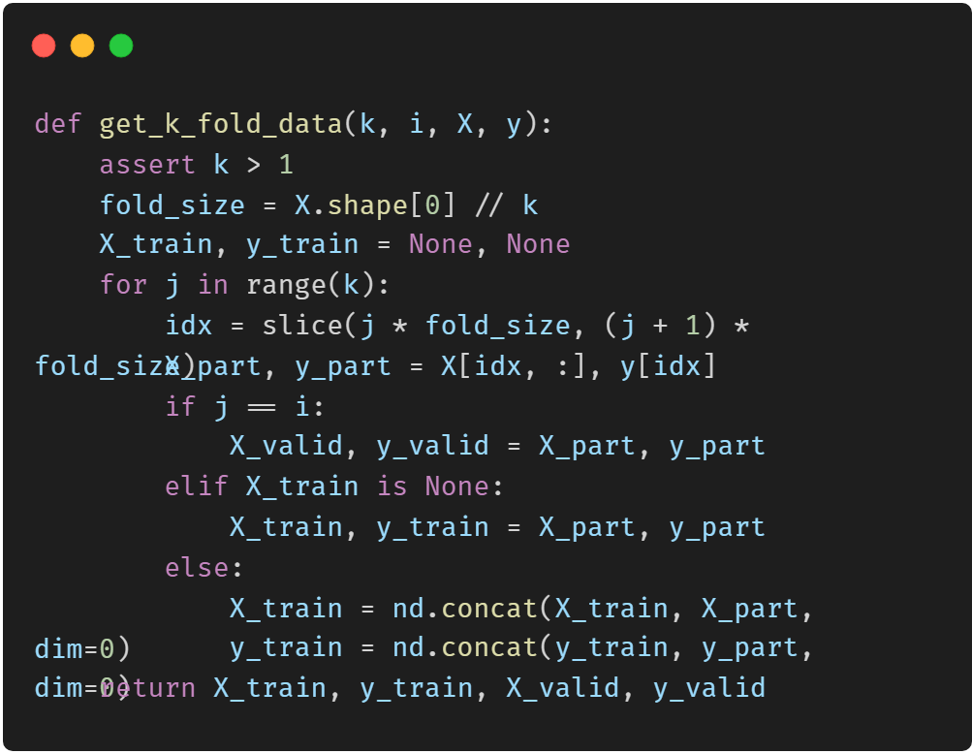
k-Fold Cross-Validation

Slide 18
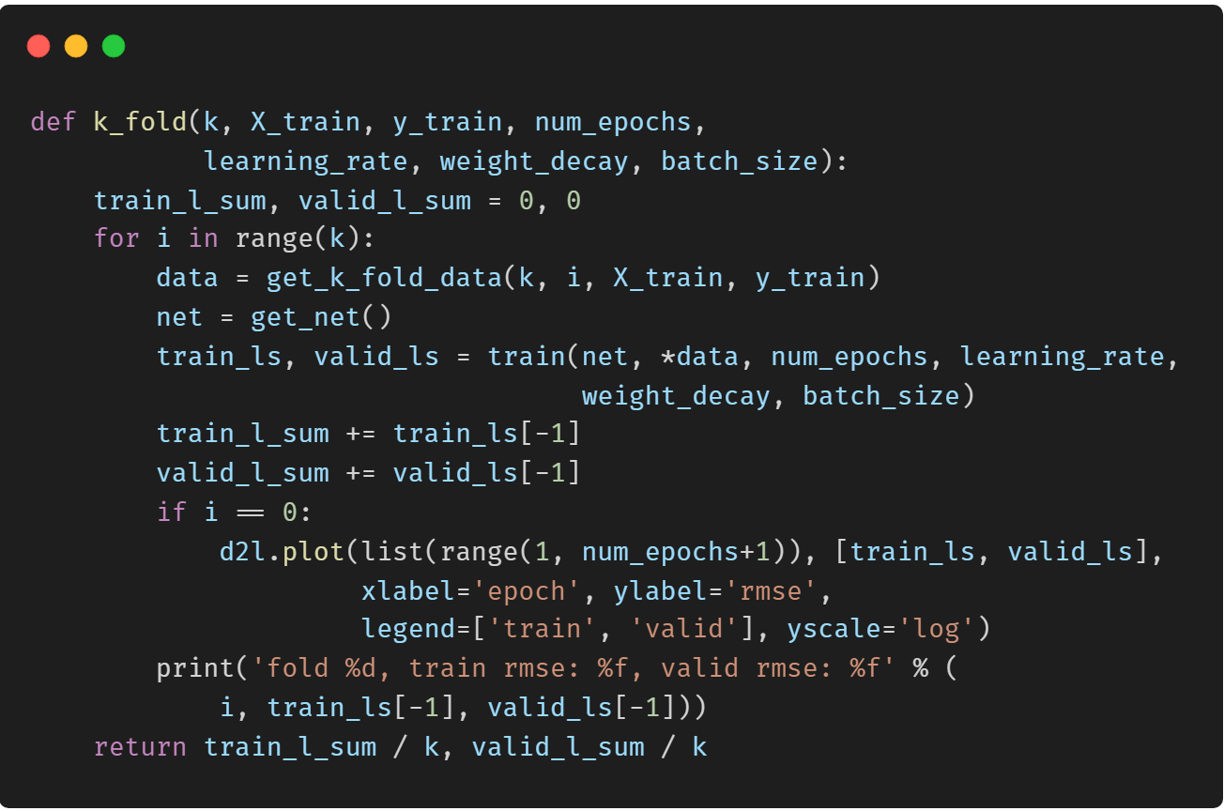
k-Fold Cross-Validation

Slide 19
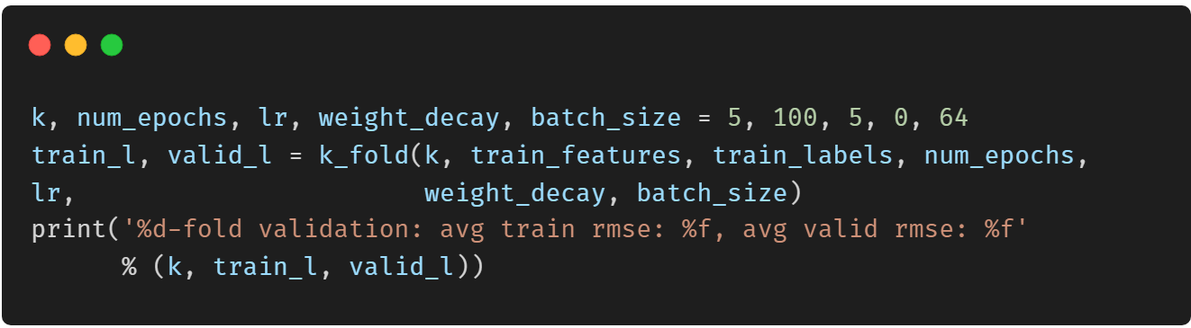
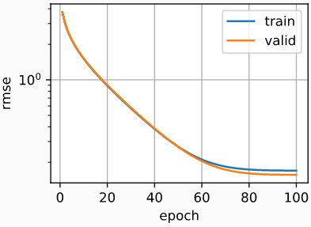
Model Selection

Slide 20
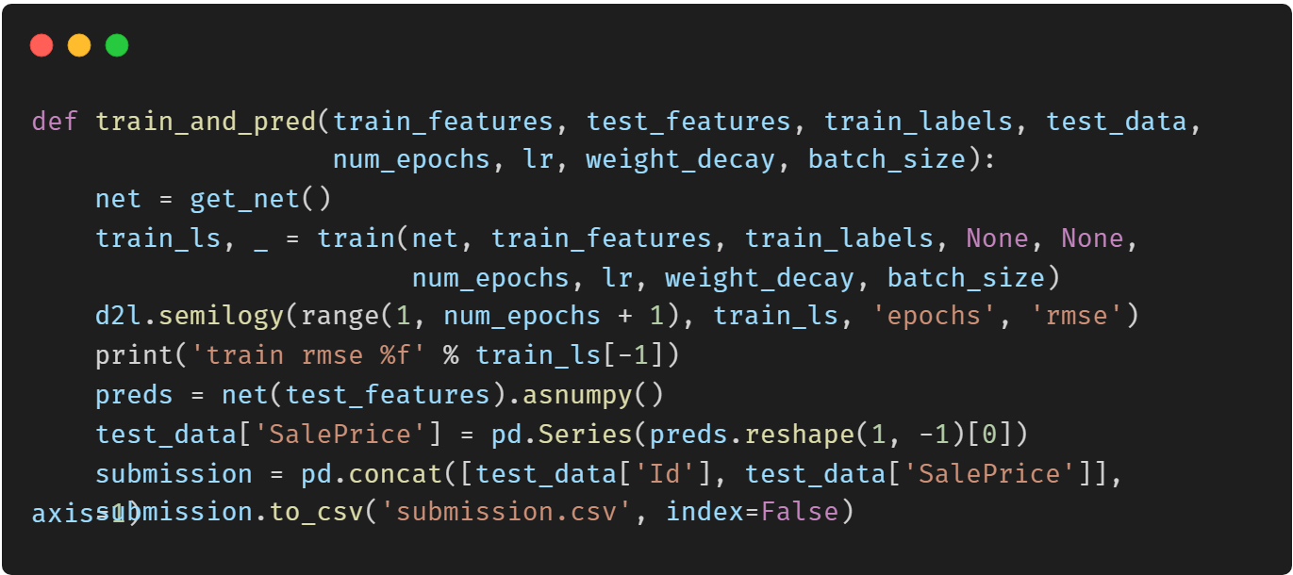
Predict and Submit

Slide 21
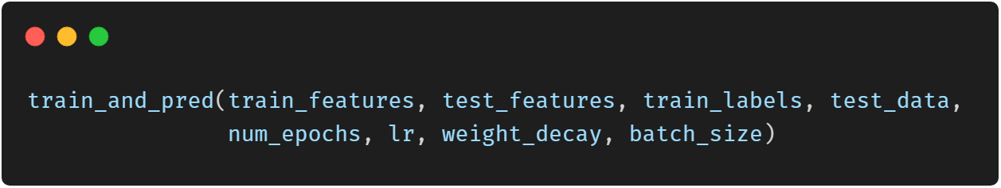
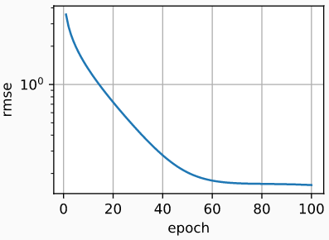
Predict and Submit

Slide 22
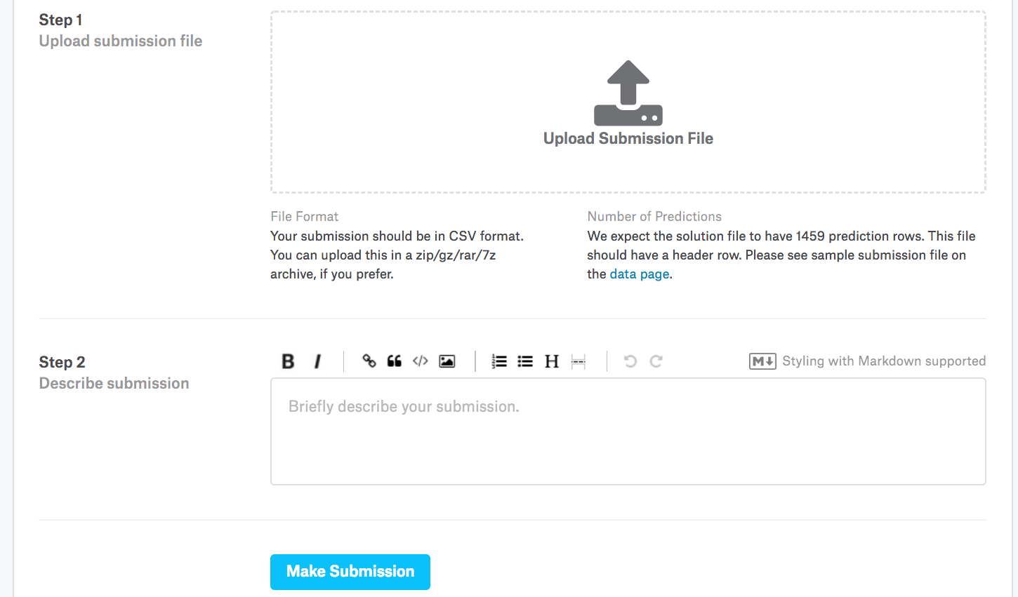
Predict and Submit

Slide 23
Thank You！
Does anyone have any questions?
Twitter: @walkercet
Blog: https://ceteongvanness.wordpress.com

Slide 24
Resources
Dive into Deep Learning

